Slide 1

A Practical Training Seminar On VOICE CONTROLLED ROBOT WITH OBJECT DETECTION(IOT) taken at IIT-KANPUR Submitted in partial fulfillment for Degree of Bachelor Of Technology
Session 2019-2020
Submitted to: Submitted By:
Mr. Amit Bohra Shivoham Tewari
17EGJCS150

Slide 2
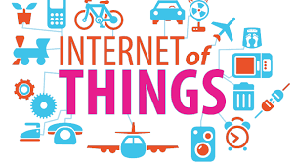
What is IoT ?
The Internet of Things (IoT) is a system of interrelated computing devices, mechanical and digital machines, objects, animals or people that are provided with unique identifiers (UIDs) and the ability to transfer data over a network without requiring human-to-human or human-to-computer interaction.

Slide 3
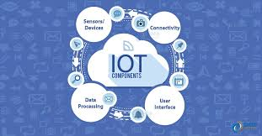
How IoT works?
Sensors/Devices – Used for Data Collection
Connectivity – Used for sending Data to Cloud
Data Processing – Software works on the Data received
User Interface – Information made useful for End-User

Slide 4
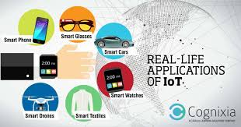
Applications Of IoT
Consumer applications
Smart home
Elder care
Commercial application
Industrial applications
Infrastructure applications

Slide 5
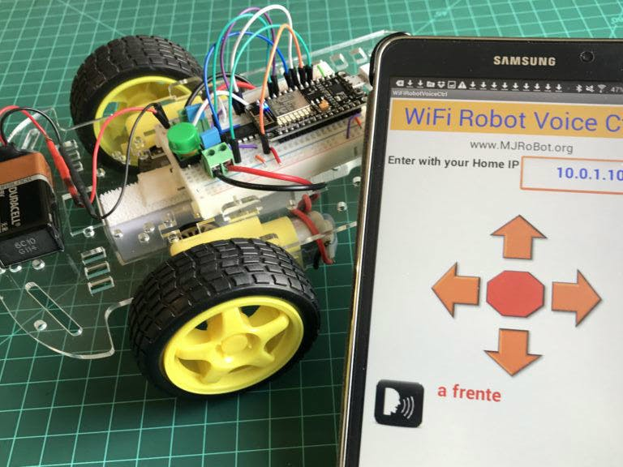
Wi-Fi Voice Controlled Robot With NodeMCU and Object Detection by Raspberry Pi

Slide 6
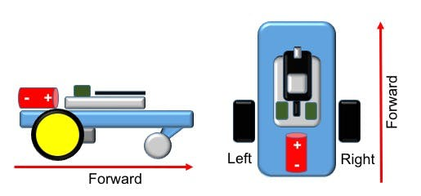
Components Required:
Hardware Components:
1. Node MCU Breakout Board
2. Android Device
3. L298N Motor Driver
4. Raspberry Pi 3 Model B+ with camera
5. Motor Robot Car Chassis Kit
6 . Some Batteries and Portable Charger
Software Components:
1. Arduino IDE
2. Raspberry Pi

Slide 7
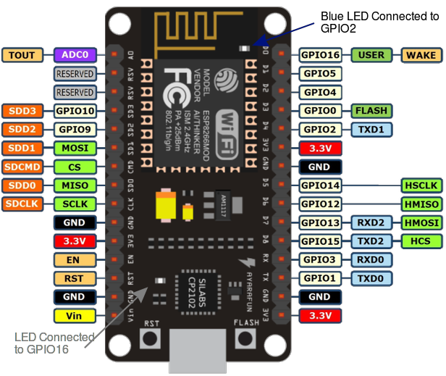
Node MCU (ESP-8266)

Slide 8
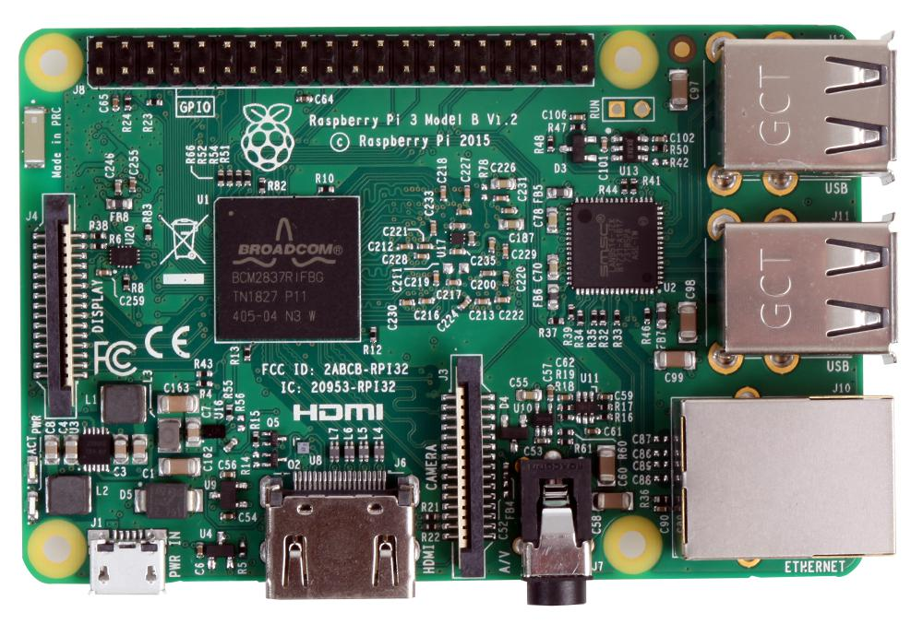
Raspberry Pi

Slide 9
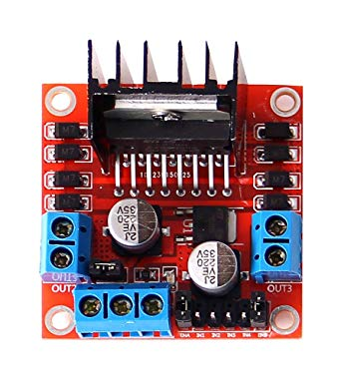
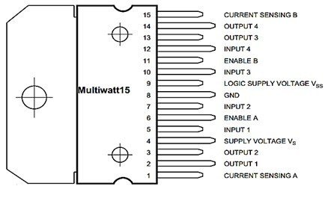
Motor driver – l298n

Slide 10
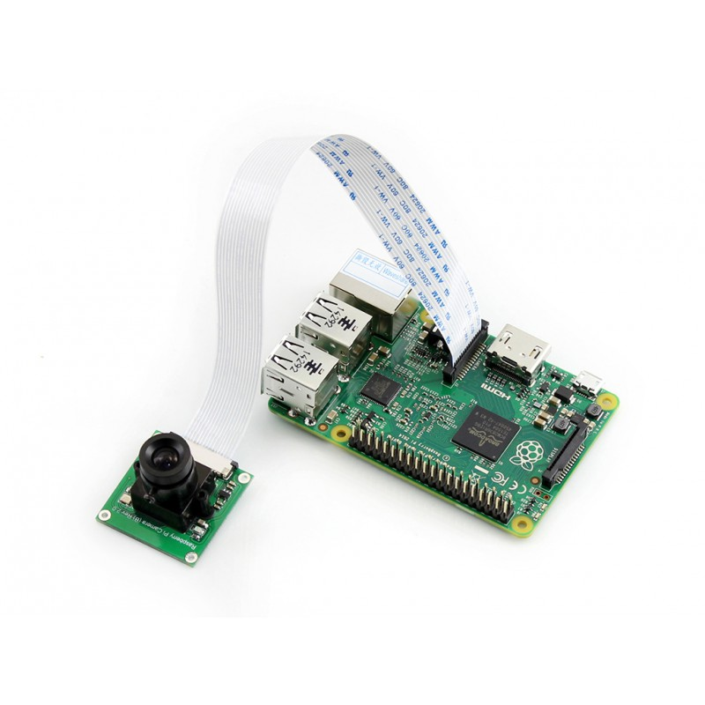
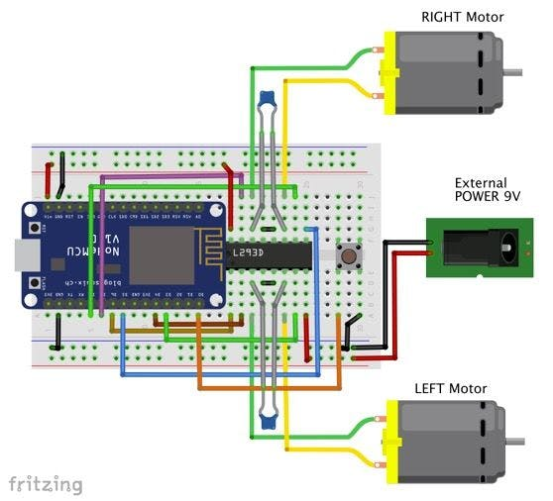
Connections

Slide 11
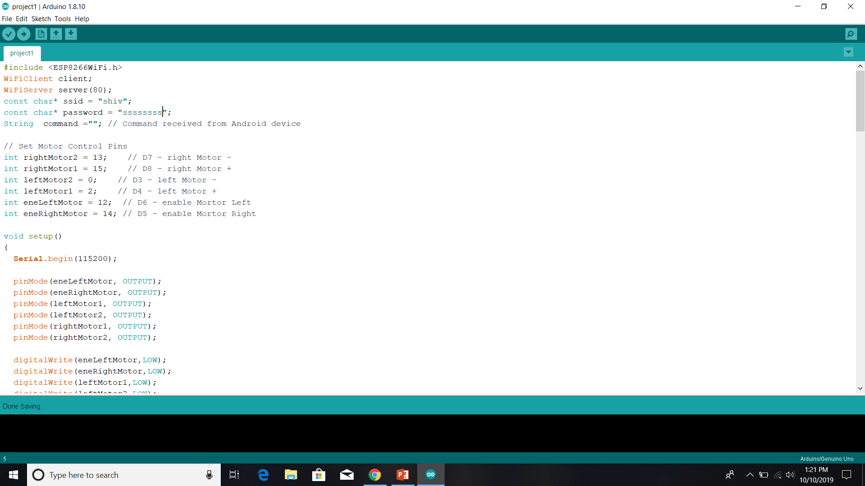
SCREENSHOTS OF CODE:

Slide 12
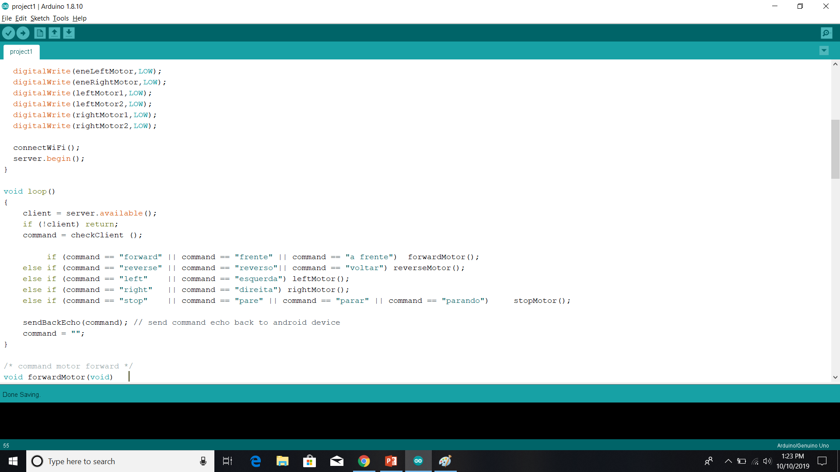

Slide 13
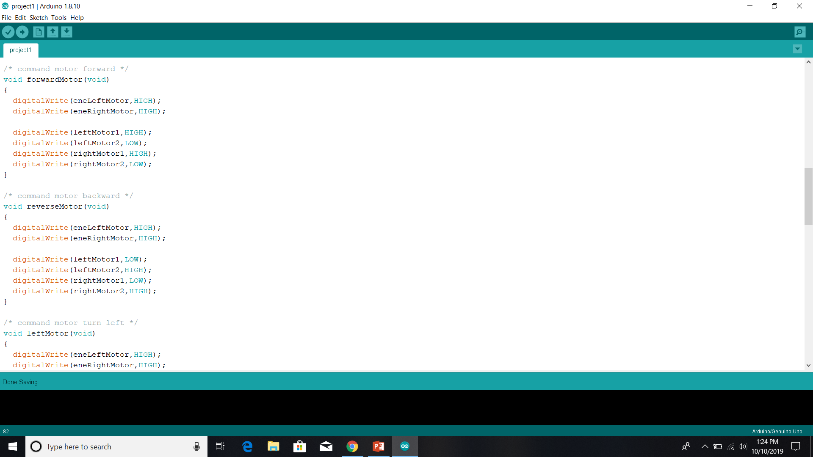

Slide 14


Slide 15
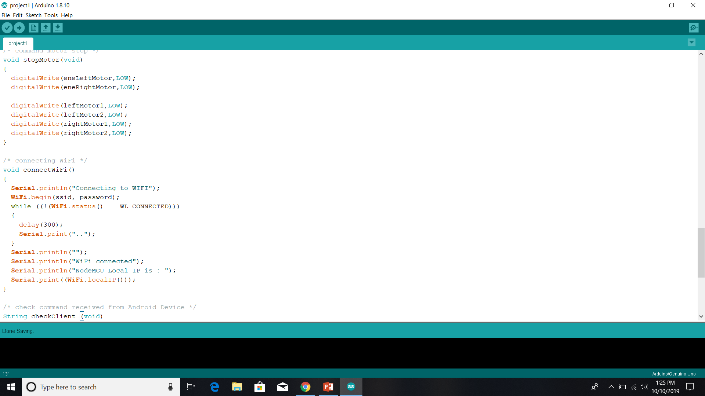

Slide 16
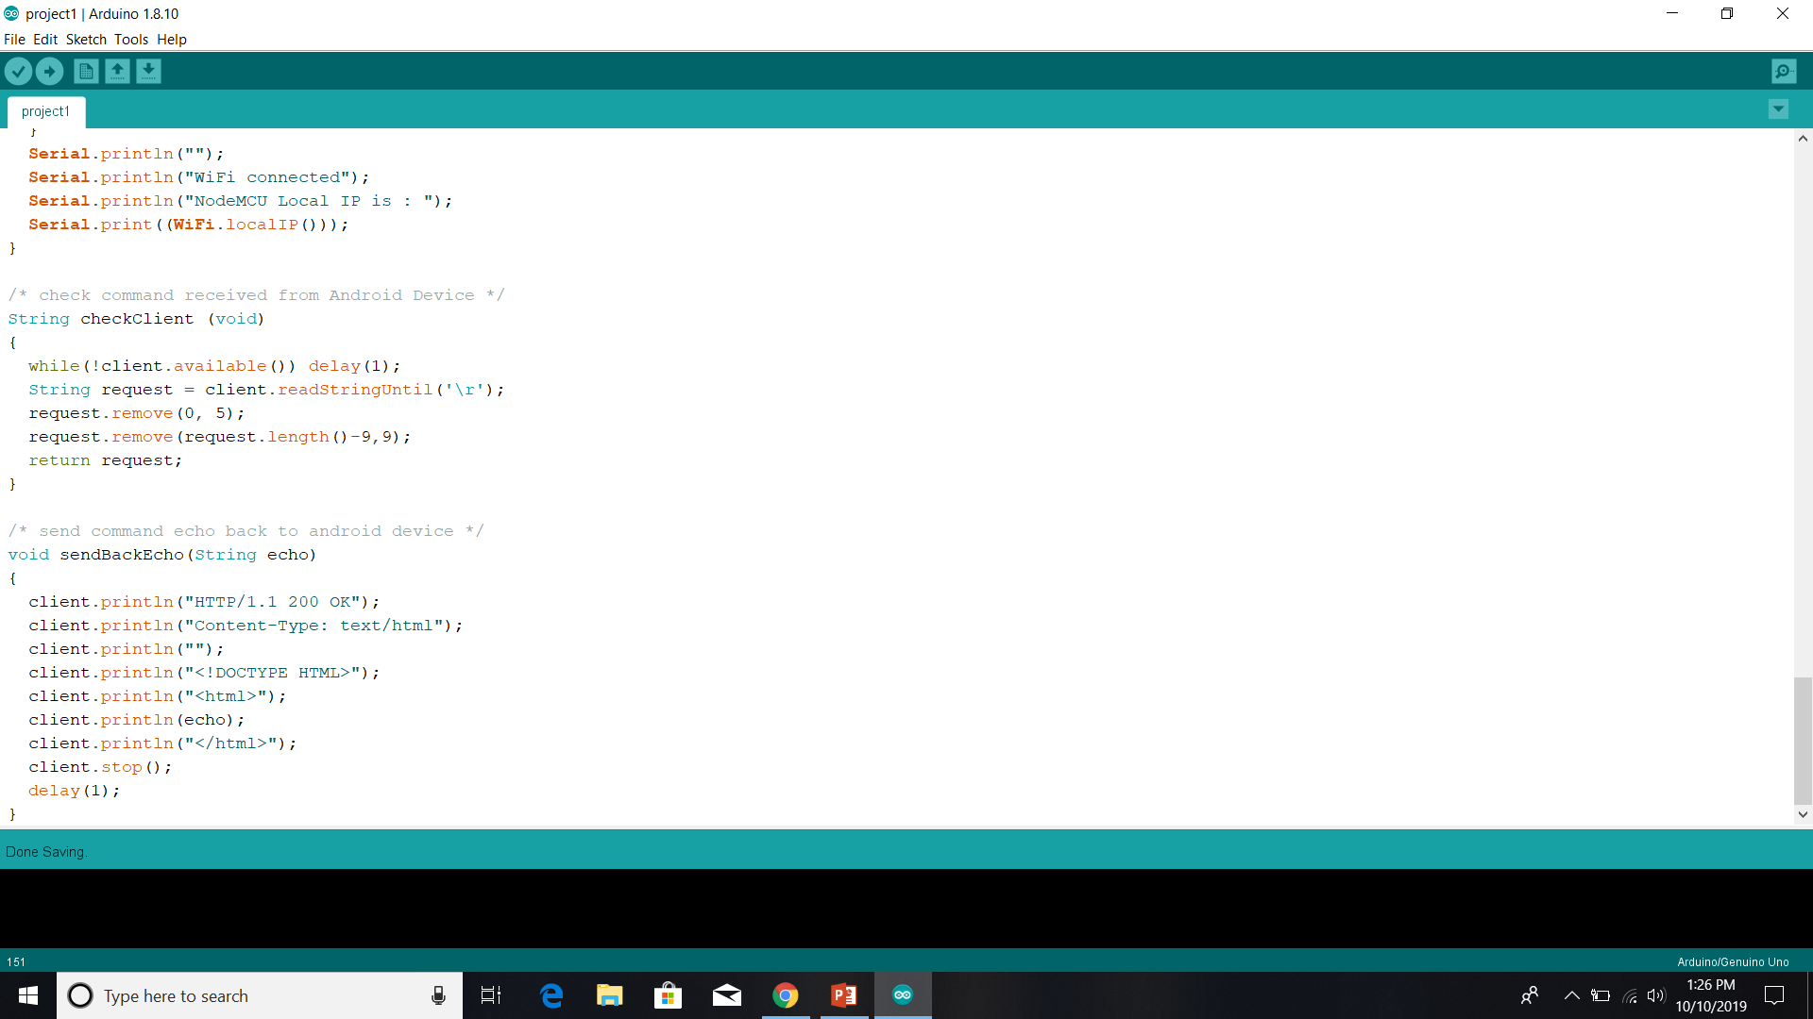

Slide 17
THANK YOU…!!!!

Slide 18
ANY QUERIES ??

